Slide 1
Structural Vibration Analysis

Slide 2
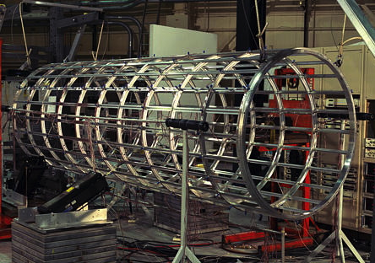
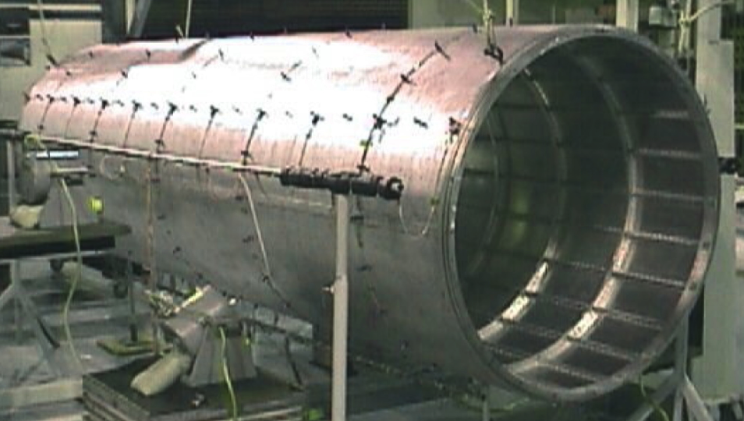
NASA Aluminum Testbed Cylinder (ATC)

Slide 3
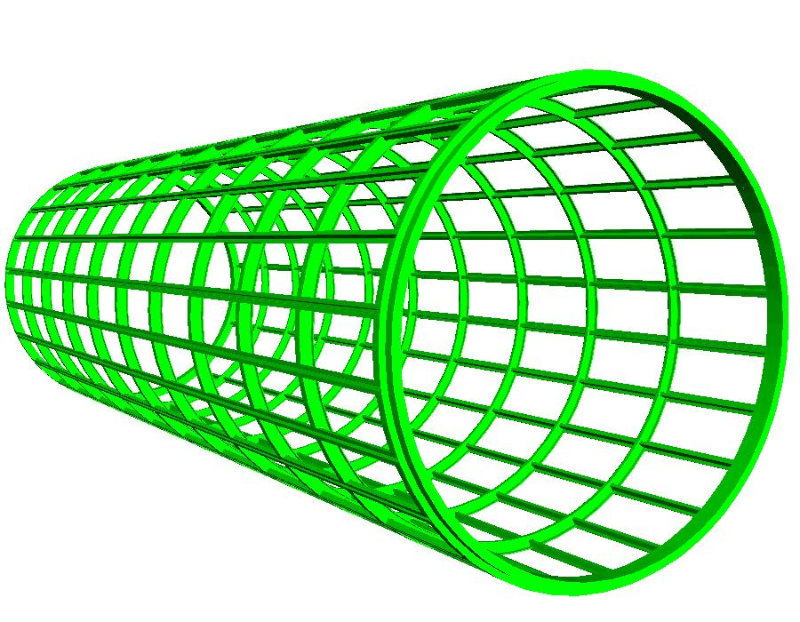
NASA ATC Frame

Slide 4
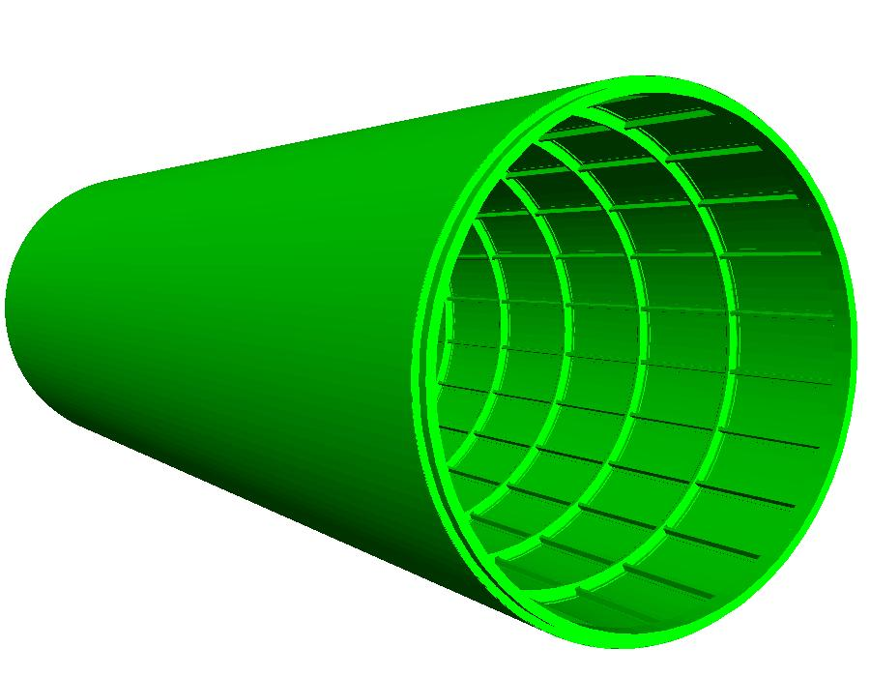
NASA ATC Frame and Skin

Slide 5

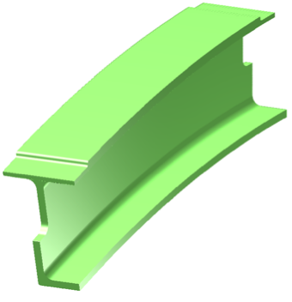
Main Rib

Slide 6
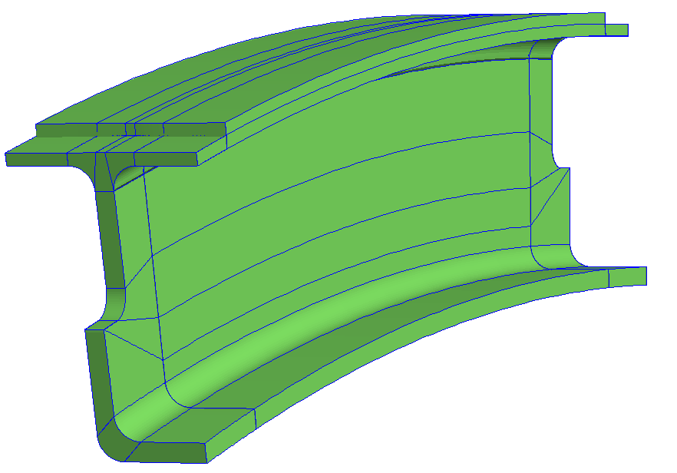
Coarsest mesh
15° segment of main rib

Slide 7
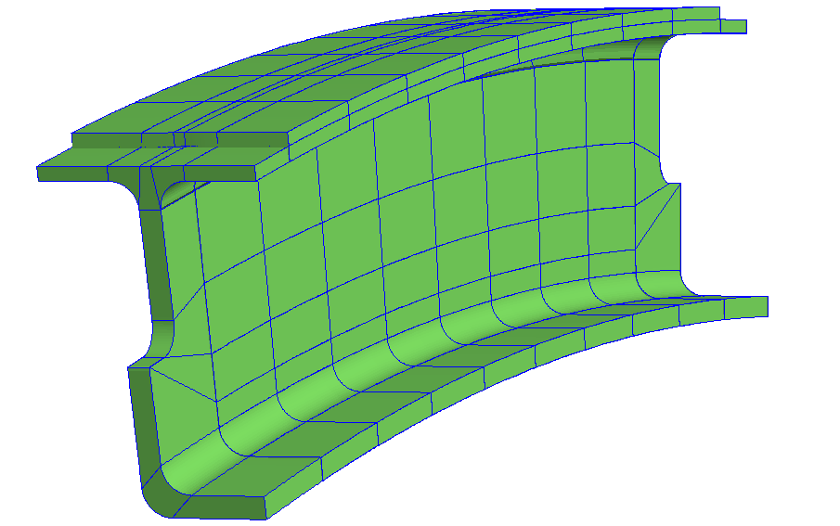
Mesh 2

Slide 8
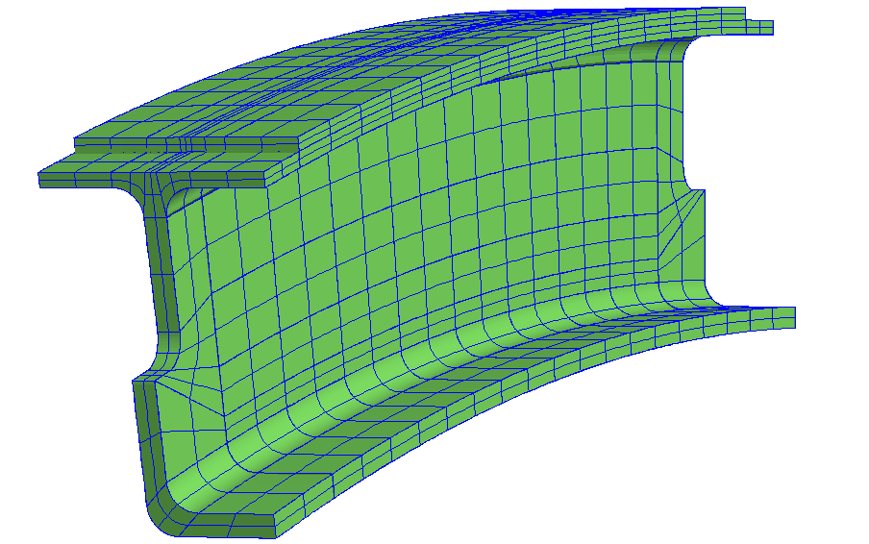
Mesh 3

Slide 9
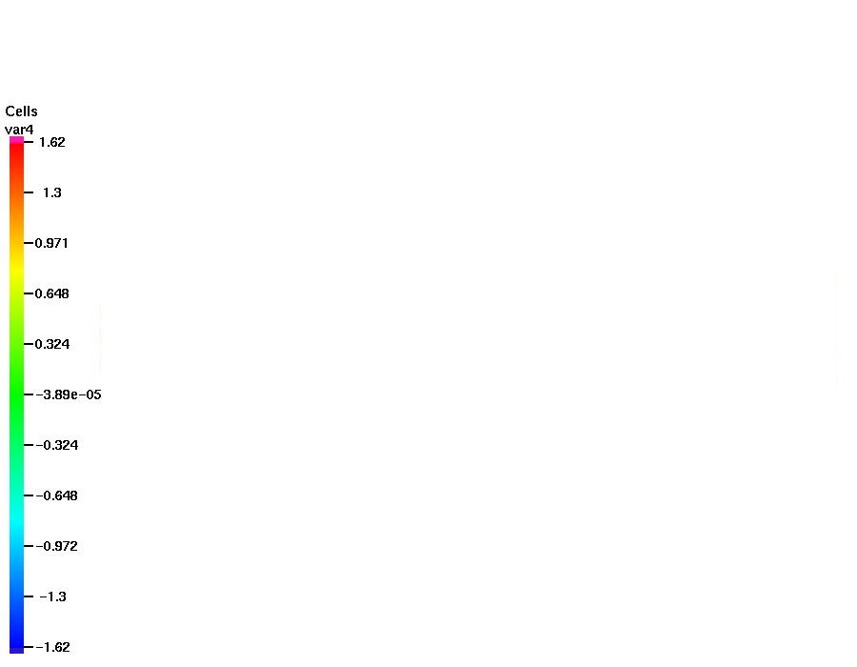
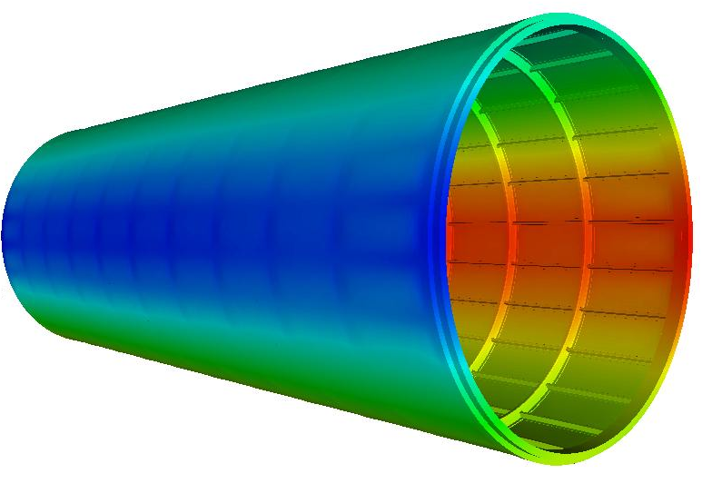
First Rayleigh Mode
x-displacement

Slide 10
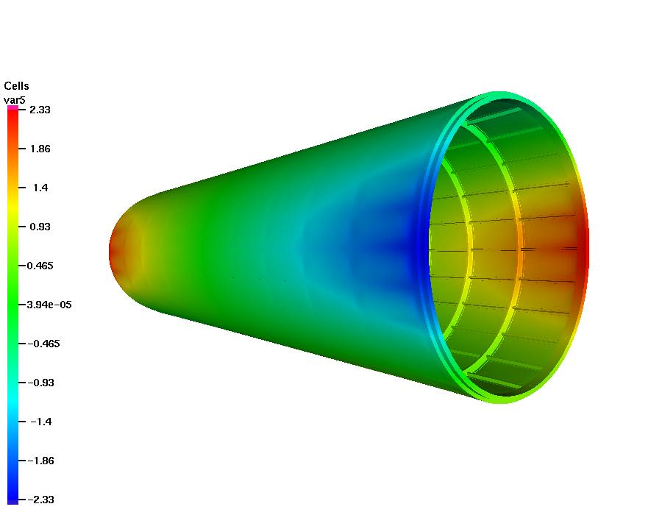
First Love Mode
x-displacement

Slide 11
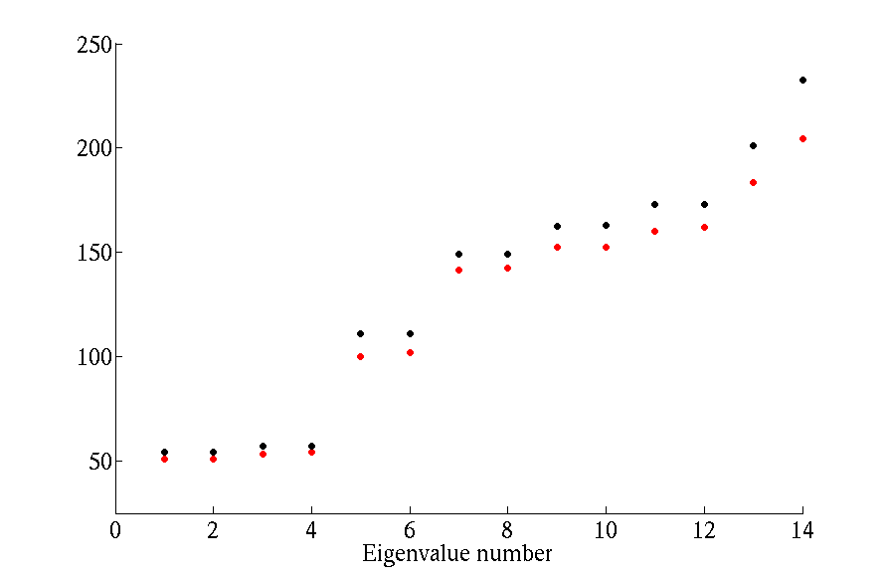
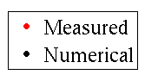
ATC Frame and Skin
Frequency (hz)

Slide 12
Vibration of a Finite Elastic Rod with Fixed Ends

Slide 13
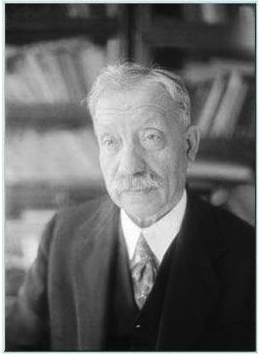
Galerkin Method for the Eigenvalue Problem
B. Galerkin

Slide 14
Comparison of Quadratic C⁰ FEM and C¹ NURBS Frequency Errors
FEM
NURBS

Slide 15
Comparison of C⁰ FEM and C^{p-1} NURBS Frequency Errors
Higher modes diverge
No approximation
Lack of robustness
Poor conditioning

Slide 16
Pythagorean Eigenvalue Error Theorem

Slide 17
Eigenvalue and Eigenfunction Errors
C¹-continuous functions (p=2)
Hughes, Evans & Reali, 2014

Slide 18
Eigenvalue and Eigenfunction Errors
C⁰-continuous functions (p=2) C¹-continuous functions (p=2)
Hugnes, Evans & Reali, 2014

Slide 19
Eigenvalue and Eigenfunction Errors
C⁰-continuous functions (p=2) C¹-continuous functions (p=2)
Hughes, Evans & Reali, 2014

Slide 20
Eigenvalue and Eigenfunction Errors
C⁰-continuous functions (p=3) C²-continuous functions (p=3)
Hughes, Evans & Reali, 2014

Slide 21
Eigenvalue and Eigenfunction Errors
C⁰-continuous functions (p=4) C³-continuous functions (p=4)
Hughes, Evans & Reali, 2014

Slide 22
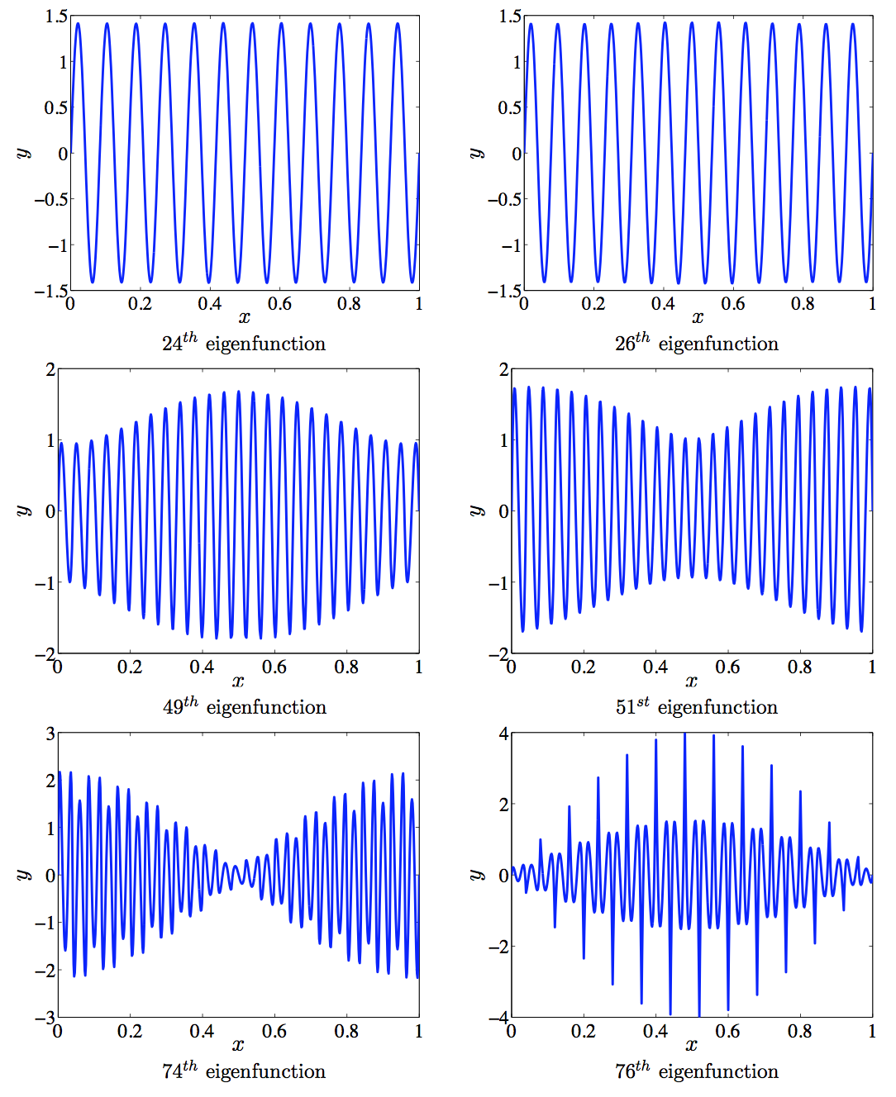
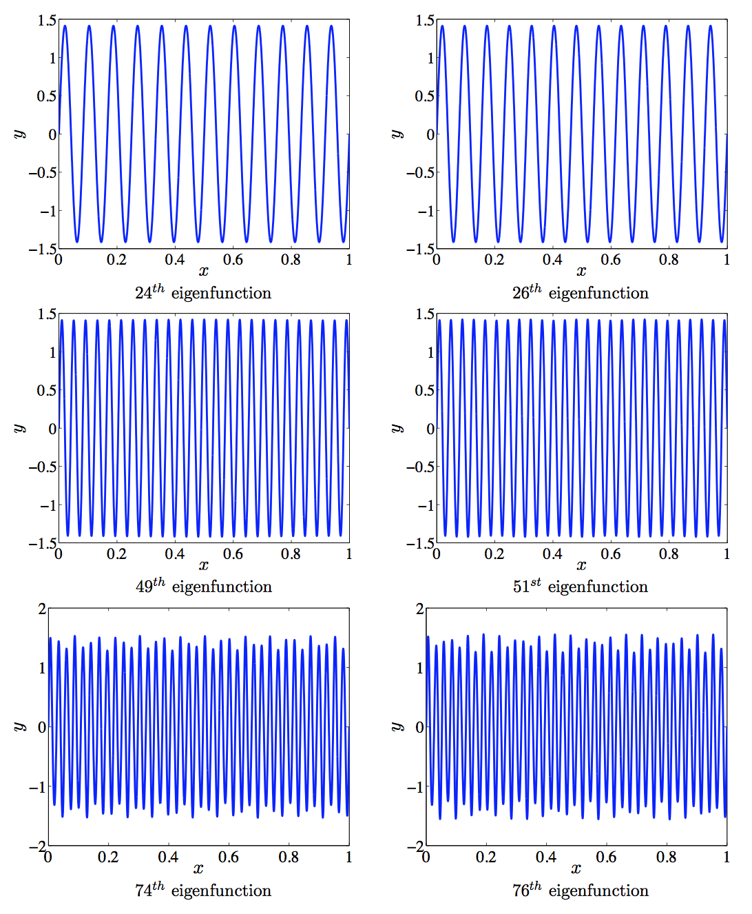
C⁰-continuous functions (p=4) C³-continuous functions (p=4)
Hughes, Evans & Reali, 2014

Slide 23
Wave Propagation Analysis

Slide 24
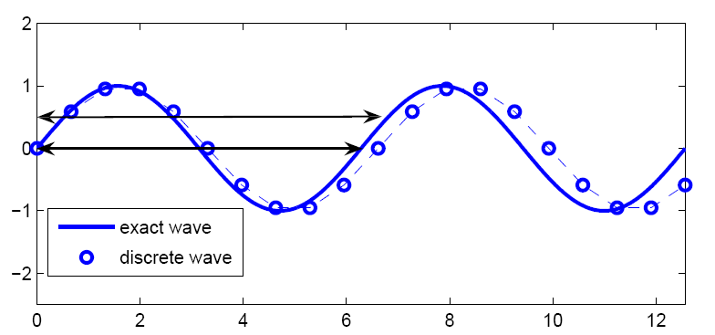
Wave Propagation in an Infinite Domain

Slide 25
Duality Principle
Frequency errors in vibrations and phase errors in wave propagation are related by a change of variables:

Slide 26
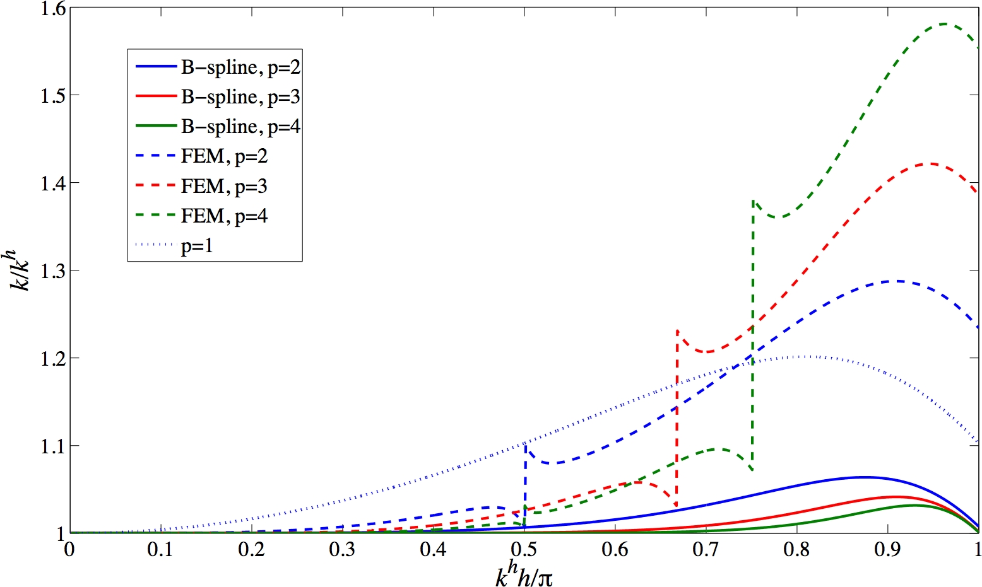
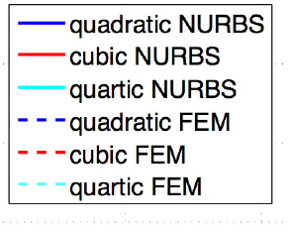
Duality of Frequency and Phase Errors
p
k

Slide 27
Helmholtz Equation Phase Error
Stopping bands
p
k

Slide 28
Helmholtz Equation Phase Error
Stopping bands
p
k
No stopping bands

Slide 29
Helmholtz equation in 1D, Dirichlet boundary conditions (31 control points for p = 3)
Wave Propagation (Leszek’s problem)

Slide 30
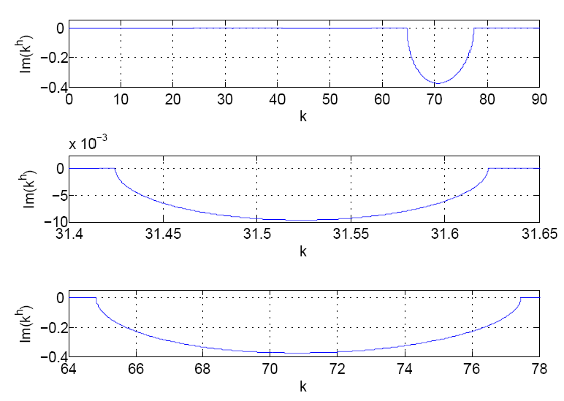
p-method stopping bands for p = 3

Slide 31
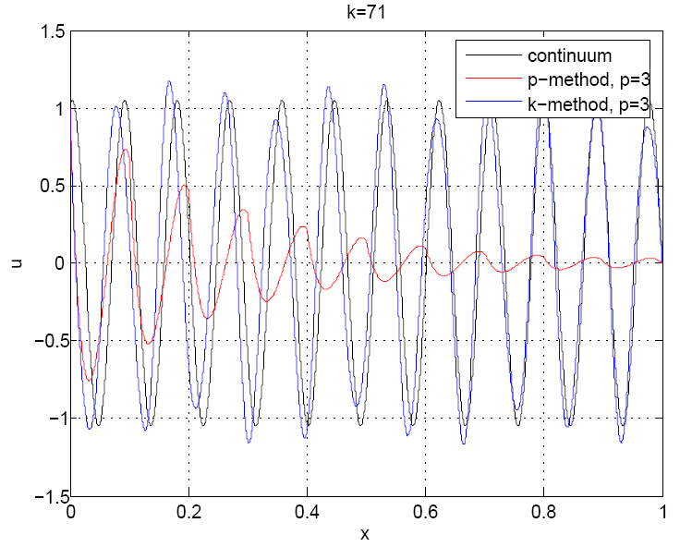
k = 71; p = 3 (inside the 2nd p-method stopping band)

Slide 32
Wave Propagation in an Infinite Domain
Model Problem:
Exact Solution:

Slide 33
Dispersion Error and Pollution
As k grows, dispersion leads to a growth in error:

Slide 34
Dispersion Error and Pollution

Slide 35
Dispersion Error and Pollution

Slide 36
Pollution: FEM

Slide 37
Pollution: FEM
BAE: Best Approximation Error

Slide 38
Pollution: NURBS

Slide 39
Pollution: NURBS
BAE: Best Approximation Error

Slide 40
Pollution: Degree 2 Comparison

Slide 41
Pollution: Degree 3 Comparison

Slide 42
Pollution: Degree 4 Comparison

Slide 43
Pollution: Degree 5 Comparison

Slide 44
Tabulated Errors at k = 4112π
Method | Normalized L2 Error | L2 Error / BAE
FEM, p = 1 | 1.39e0 | 90.21
NURBS, p = 1 | 1.39e0 | 90.21
FEM, p = 2 | 1.38e0 | 149.32
NURBS, p = 2 | 8.27e-1 | 524.74
FEM, p = 3 | 1.24e0 | 399.15
NURBS, p = 3 | 9.16e-2 | 54.74
FEM, p = 4 | 1.96e-1 | 195.31
NURBS, p = 4 | 1.05e-4 | 5.81
FEM, p = 5 | 7.67e-2 | 152.57
NURBS, p = 5 | 2.31e-6 | 1.17

